Slide 1
2024 Grants Information Session
July 26, 2023
Virtual - Zoom
1:30 pm - 3:00 pm
www.dcbarfoundation.org
grants@dcbarfoundation.org

Slide 2
Overview of Today’s Information Session
About the DC Bar Foundation
Grants Program Overview
Funding Overview
FY24 Grants Timeline
Eligibility for Grants
Standards
Priorities
Application
Grant Reporting Requirements

Slide 3
About the DC Bar Foundation

Slide 4
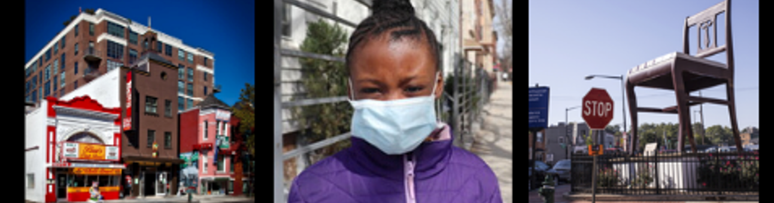
Our Mission
To fund, support, and improve legal representation of people living in poverty and in vulnerable situations, or who are otherwise underserved in the District of Columbia

Slide 5
Our Strategic Framework
Our goal is to transform the civil legal aid network, working closely with all stakeholders, so District residents have a fair and equal legal experience.
Engage all stakeholders
Fund with intention
Demonstrate that people who need services are getting them
Identify the unmet civil legal needs
Infuse racial justice and equity in our work

Slide 6
1 - Engage All Stakeholders
Funder Collaboration
District Government
Local funders
National partners (IOLTA and others)
Network Building
DC Legal Aid Transformations Network
Partnership with DC Legal Community
Loan Repayment Assistance Program (LRAP)

Slide 7
DC Legal Aid Transformations Network
Purpose
To advance a user-centered system, grounded in fostering wellbeing, anti-racism and anti-poverty, starting with creating a coordinated intake and referral system in DC and evolving into a “network of networks” for connectivity, alignment, and action
Network Weaving
Get in touch with Network Project Manager Michanda Myles
Network Convening
Save the Date for September Convening (Wednesday, September 13)

Slide 8
LRAP - Employers
One-year, interest-free, forgivable loans of up to a statutory limit of $12,000 per year to qualified attorneys providing legal assistance to underserved DC residents
Which Organizations are Qualified Employers?
DC-based, non-profit, tax-exempt charitable organizations that provide legal services to the District’s underserved residents and approved by the DC Bar Foundation.
Email LRAP@dcbarfoundation.org for more information.

Slide 9
LRAP - Participants
Who is Eligible to Receive Benefits?
To be eligible, an employee must be:
1. A lawyer;​
2. Employed by a qualified organization;​
3. Having a current annual salary (including bonuses and other wages) of less than $100,000); and,​
4. Working not less than 35 hours per week for full-time benefits (17 hours per week for part-time benefits).​
Email LRAP@dcbarfoundation.org for more information.

Slide 10
2 - Identify the Unmet Civil Legal Needs
Continuous Learning
Grant Reporting
Third-party Evaluations
Priority Alignment
Access to Justice Commission
Community Engagement
Innovation & Infrastructure
Coordinated Intake & Referral

Slide 11
Coordinated Intake & Referral
Purpose
Provide a single point of entry that will allow DC residents to access civil legal aid seamlessly and efficiently
Approach
Ongoing community input and feedback
Leverage existing resources
Continuous learning

Slide 12
3 - Infuse Racial Justice & Racial Equity in Our Work
Internal Policies and Practices
Internal Audits
Grantmaking
Capacity Building

Slide 13
Demographic Data from 2023 Survey
35 out of 37 organizations responded (95%)
Surveyed board and staff demographics
Executive staff = executive directors and organization leadership
Support staff = supervising attorneys, line attorneys, legal staff, service staff, administrative staff

Slide 14
2023 Demographic Data – Overall
Board
48% female
54% white, 27% black
Staff
69% female
50% white, 20% black

Slide 15
Racial Equity – Capacity Building
Racial Equity Trainings
1.0 Series - foundational skills
2.0 Series – facilitation skills
Listening Sessions
Surveys
Interviews

Slide 16
4 – Fund with Intention
Strategic Investments
Systems Change
Community Engagement
Pro Bono Participation

Slide 17
5 – Demonstrate That People Who Need Services Are Getting Them
Evaluation
Recognition of Excellence
Fall Reception & Scoutt Prize Presentation (Nov 8)
Communications
Lifting up your stories
Sr Communications Officer Khesia Taylor

Slide 18
Grants Program Overview

Slide 19
General Support Grants
45 years of grantmaking under General Support Grants
General operating and project support grants
Revenue from private fundraising and IOLTA
More than $34M awarded since 1978

Slide 20
Access to Justice (ATJ) Grants
16 years of grantmaking under ATJ Grants
Funding from the District government
Three categories: underserved areas, housing-related matters, and shared legal interpreter bank
More than $81M awarded since 2007

Slide 21
Civil Legal Counsel Projects Program (CLCPP Grants)
6 years of grantmaking under CLCPP
Funding from the District government
Provide representation in covered proceedings
Ongoing evaluation requirement
Funded $31M to CLCPP since 2018

Slide 22
Breakout Groups

Slide 23
"The future of legal aid in DC looks like . . ."
How do you envision the role of legal aid organizations evolving in the next two-three years?
What changes would you like to see in the broader legal aid landscape in DC?

Slide 24
Funding Overview

Slide 25
2023 Funding
We are proud to have invested over
$26 Million in the District in 2023

Slide 26
ATJ Initiative Funding for FY24
Total Funding of $31,668,000
Access to Justice
Civil Legal Counsel Projects Program
Loan Repayment Assistance
Covers grants, training and technical assistance, evaluation, and administration

Slide 27
Questions?

Slide 28
Grants Timeline

Slide 29
2024 Grants Timeline
Applications due
Awards announced
Grant year
August 31, 2023 at 11:59 pm
December 2023
January 1, 2024 - December 31, 2024

Slide 30
Eligibility

Slide 31
Eligibility
To be eligible for a grant, you must:
For CLCPP grants, in addition you must:
Be a not-for-profit DC corporation;
Have tax-exempt status under Section 501(c)(3) of the Internal Revenue Code;
Operate primarily within the District of Columbia;
Be located within the District of Columbia;
Deliver civil legal services to low-income and under-served residents of DC (or support the provision thereof)
Possess expertise in housing law, landlord-tenant law, or related experience;
Demonstrate expertise in recognizing and responding to multiple legal issues facing low-income DC residents;
Engage only in “covered proceedings” with these funds; and
Possess adequate infrastructure and expertise to provide consistent, high-quality oversight, training, evaluation, and strategic responses to emerging or changing needs in the client communities served; or
Be a nonprofit organization that applies jointly with a legal services provider that meets the requirements above.

Slide 32
Standards

Slide 33
Standards
Organizations must have systems in place that align with widely accepted industry standards for promoting quality, efficiency, and effectiveness
ATJ and CLCPP projects should establish performance goals and report on their progress towards stated goals.
Examples of performance goals include the number of clients provided legal services, number of community outreach and training events held, number of pro bono attorneys trained, and any other activities to be funded under the requested grant.
A strong proposal will demonstrate that the applying organization meets or exceeds the standards

Slide 34
Funding Priorities

Slide 35
Funding Priorities
ATJ ONLY: Address underserved areas OR housing-related issues in the District OR support a shared legal interpreter bank
CLCPP ONLY: Address covered proceedings related to eviction, rent increases, housing subsidy terminations, and other "covered proceedings" (consult the statute)
Expand the number of DC residents provided legal assistance
Avoid duplication of services
Make legal assistance more accessible
Expand pro bono participation
Leverage DCBF resources
Test innovative approaches for achieving priorities
A strong proposal will address one or more of the most pressing legal needs of the District's residents with low incomes, and make legal services accessible to this population
A strong proposal will address one or more of the funding priorities

Slide 36
Application

Slide 37
Application Overview
Three parts:
Organizational Data: information about your organization only
Only submit organizational information ONCE
Proposal: information about the proposal only
Proposal Attachments: attachments related to the specific proposal
Due by 11:59 p.m. ET on August 31, 2023

Slide 38
Part One: Organizational Profile
Part One: Organization Profile should only be submitted once
Organization, Budget, and Legal Staff
Mission Statement and Legal Services
Executive/Board Information
Systems for Promoting Quality, Efficiency, and Effectiveness in the Delivery of Civil Legal Aid
Demographic Information
Required Organizational Attachments:
Nonprofit Status
Organizational Budget
Form 990
Most Recent Audited Financial Statements

Slide 39
Part Two: Proposal Data
Part Two: Project information completed for every project
Executive Summary
Funding Request, Budget, and Staffing
Need and Project Description
High-level, elevator pitch of your proposal
Capacity and Outreach
Performance Measures
CLCPP ONLY: Target Population(s), Organizational Alignment with the Requirements of CLCPP, Impact of Funding by Demographic Categories

Slide 40
Part Two: Proposal Data cont’d
ATJ & CLCPP ONLY: Performance Measures
Performance Measures for Legal Services Provided to DC Residents who are Low-income or Underserved
Performance Measures for Increasing Accessibility to Legal Services (should be percentages, not total number)
CLCPP: Performance Measures for Pre-Court Intervention
Performance Measures for Outreach and Training
Performance Measures for Pro Bono Development

Slide 41
Part Three: Proposal Attachments ATJ
Attachment
ATJ Application
Data Packet
Required
Resumes
Required & must include job description if hiring for vacant positions
Signed Application via DocuSign
Required

Slide 42
Part Three: Proposal Attachments CLCPP
Attachment
CLCPP Application
Data Packet
Required
Resumes
Required & must include job description if hiring for vacant positions
Data & Info Collection Requirements
Required
Signed Application via DocuSign
Required

Slide 43
Part Three: Proposal Attachments General Support
Attachment
General Support
Project Support
Project Budget
Do not include
Required
Funding
Required
Required
Signed Application via DocuSign
Required
Required

Slide 44
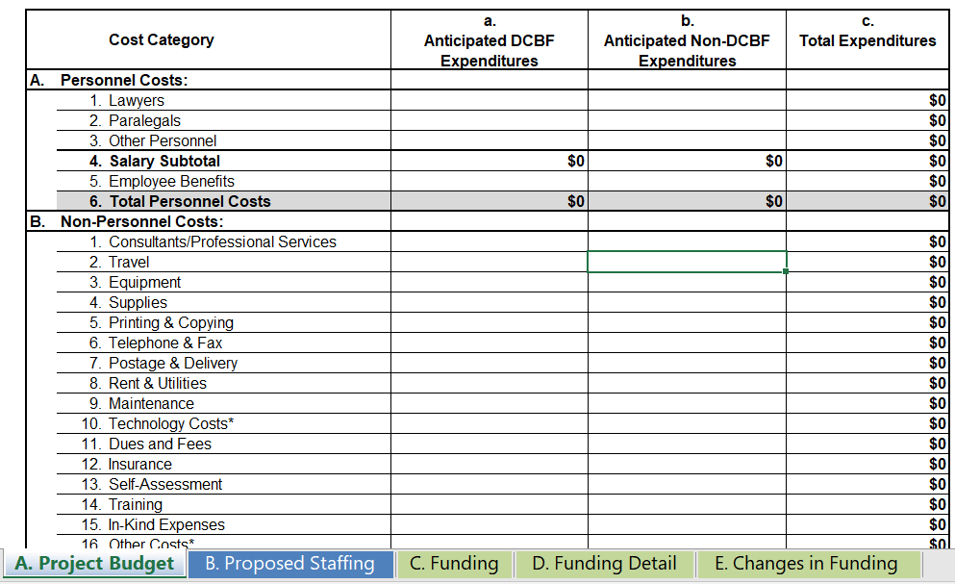
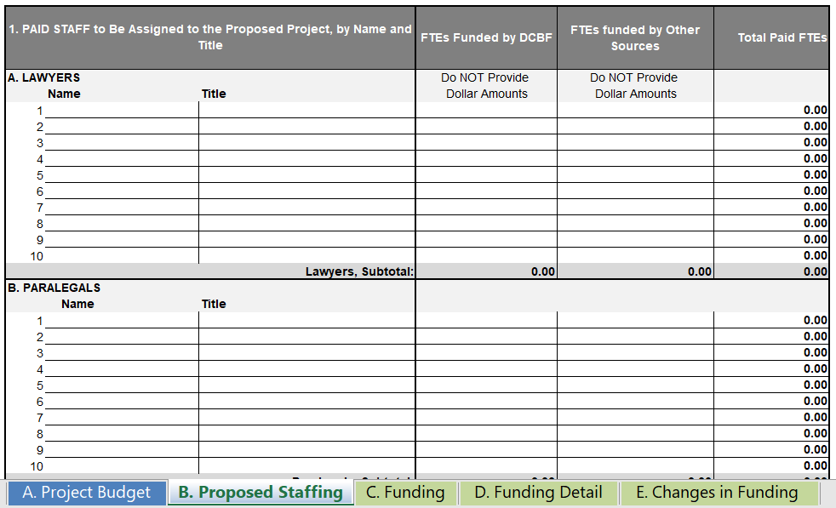
Attachment 2B: Data Packet
Tab A. Project Budget
January 1, 2024 to December 31, 2024
Two columns: a) anticipated expenditures covered by DCBF funding request, and b) anticipated expenditures covered by other funds
Tab B. Proposed Staffing
Provide full-time employees, not dollar amount
Lawyers: individuals who carry a caseload (e.g. staff attorneys, supervising attorneys, law fellows, and law school graduates)
Paralegals: whether employed directly or supervised by the organization and whether part-time, full-time, or temporary
Other Personnel: individuals other than lawyers and paralegals who do not carry a caseload (e.g. executive director, legal director, administrator, etc.)

Slide 45
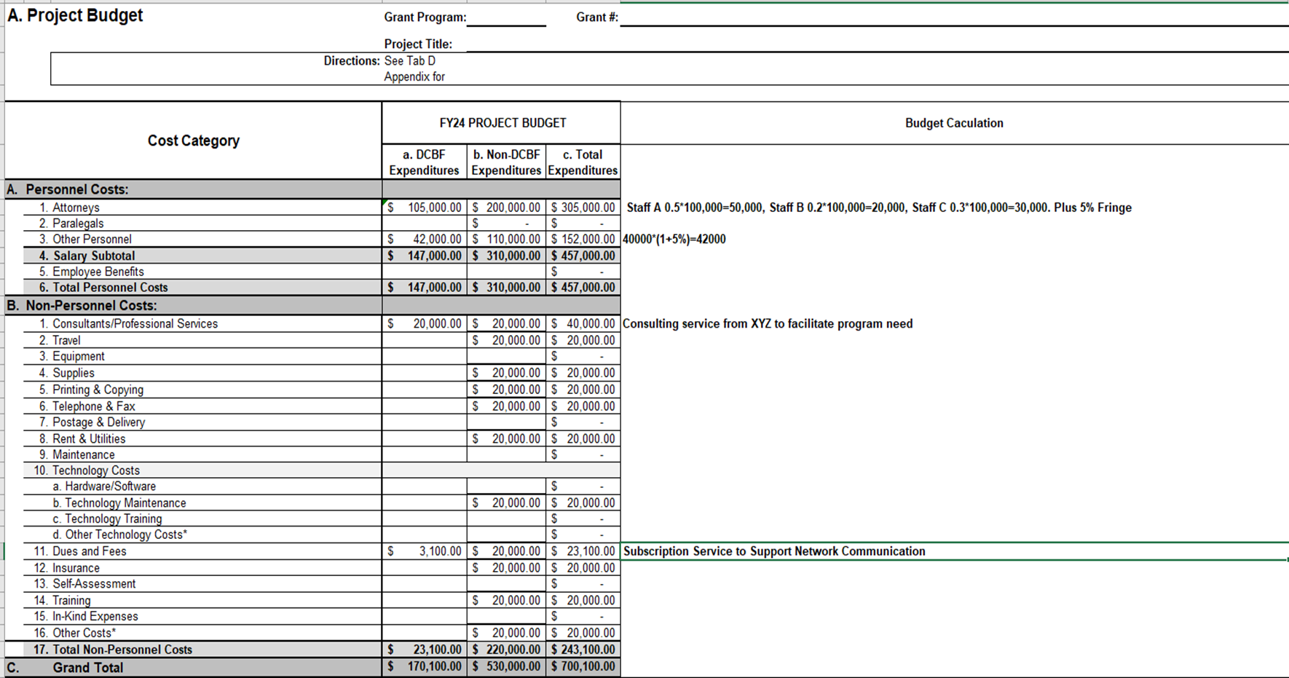

Slide 46
Budget Narrative Example
Personnel Cost:
The total budget for personnel salaries is $140,000 from the organization’s CLCPP grant. Based on historical data, we estimate a fringe rate of 5%. Three (3) attorneys will be working on cases under this program at an annual salary of $100,000. Attorney A is estimated to spend 50% of their time to this program, with Attorney B at 20% and Attorney C at 30%. The non-attorney staff on this project will be one (1) full-time employee on this program at a salary of $40,000.

Slide 47
Budget Narrative Example
Non-Personnel Costs:
Consulting/Professional Services:
The overall consultant expense is projected to increase by roughly $5,000, from $15,000 in FY23 to $20,000 in FY24. This increase is due in large part to specialized expertise needed for training, evaluation, capacity building, and program implementation for this CLCPP project. The FY24 budget includes funding for continued work with ABC Corporation to conduct a second evaluation of the existing civil legal aid network.
Dues and Fees:
The subscription to ABC is to support the CLCPP network communication with all subgrantees/Clients estimated an annual fee of $3100.
Other Costs:
Other costs include subscriptions to software like Microsoft Office, Hootsuite, and Adobe, as well as office supplies ordered from Amazon, etc.

Slide 48
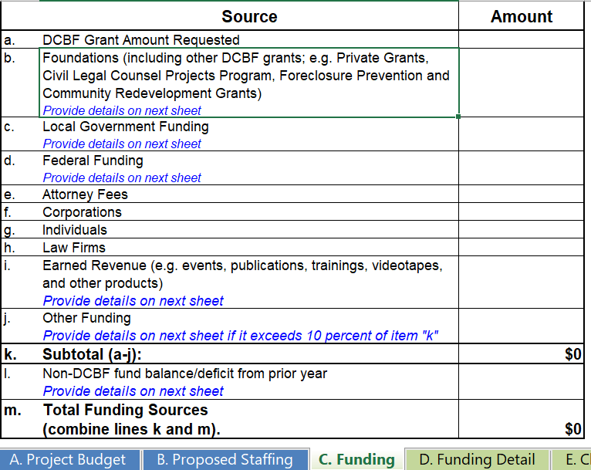
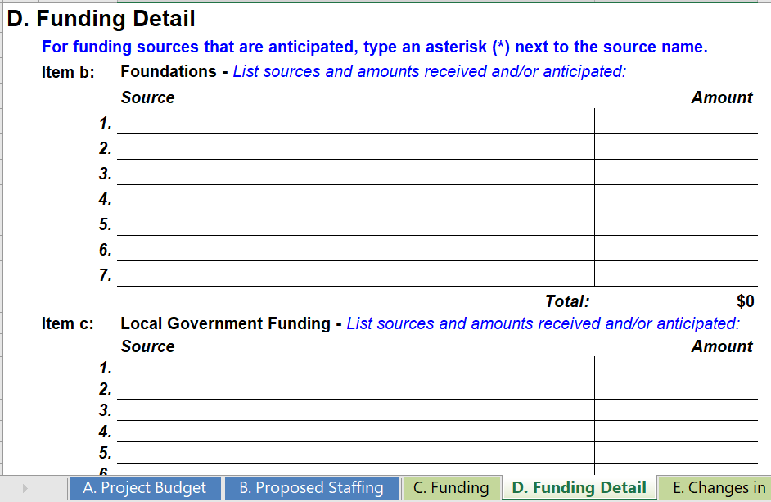
Attachment 2B: Data Packet cont'd
Tab C. Funding
Anticipated financial support for the specific project for which the grant is requested
Do not include in-kind donations
Tab D. Funding Detail
Tab E. Changes in Funding
Indicate any significant changes in funding in the most recent fiscal year
Note: For General Support Grants, complete tabs A & B for Project Support; tabs C, D, & E for General Operating Support

Slide 49
Grant Reporting Requirements

Slide 50
Reporting Requirements
ATJ and CLCPP Grants
Quarterly Financial Reports
Semiannual Programmatic Report
Final Programmatic Report and Client Story
CLCPP Grants
Ongoing Data Collection
General Support Grants
Semiannual Programmatic Report
Final Programmatic Report and Client Story

Slide 51
Training and Technical Assistance
TOPICS | PROVIDER | TIMEFRAME
Financial Due Diligence | BDO | February 2024
Litigation Skills, Impeachment Training and Trial Advocacy Training | Washington Council of Lawyers | January 2024– May 2024
Racial Equity 1.0 Training Series | Service Never Sleeps | March-May 2024
Racial Equity 2.0 Training Series | TBD | TBD
Racial Equity Cohort and/or Racial Equity Community of Practice | TBD | TBD
Topic-Specific Cohorts (Eviction Defense and Immigration) | Washington Council of Lawyers | TBD

Slide 52
Questions?

Slide 53
Join Us! DC Bar Foundation Key Dates
July 31: Young Lawyers Network Leadership Council Application Deadline
September 13 : DC Legal Aid Transformations Network Convening
Nov 8: Fall Reception and Scoutt Prize Award Ceremony (6:30pm-8:30pm)

Slide 54
Contact Us!
For general inquiries or questions,
please email us at:
grants@dcbarfoundation.org
lrap@dcbarfoundation.org

Slide 55
Connect With Us!
https://twitter.com/DCBarFoundation
https://www.youtube.com/user/TheDCBarFoundation
http://www.facebook.com/dcbarfoundation
http://www.linkedin.com/company/1113110
https://instagram.com/dcbarfoundation/

Slide 56
Thank You!

